Slide 1
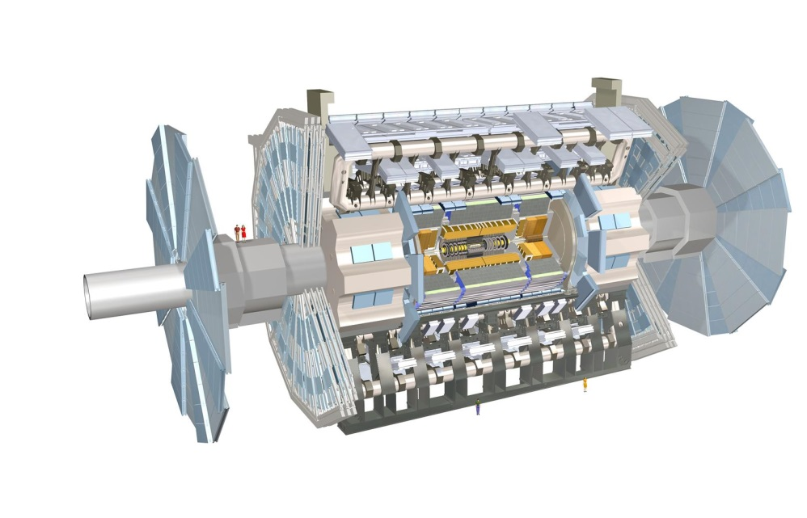
ATLAS Masterclass-in-a-box
Data File 5 (Events 161-200)

Slide 2
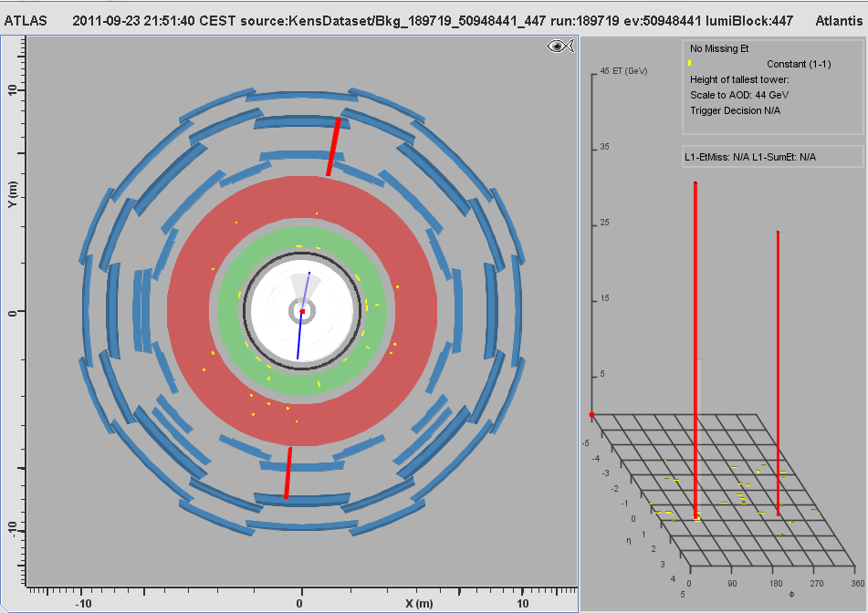
MC Event #161

Slide 3
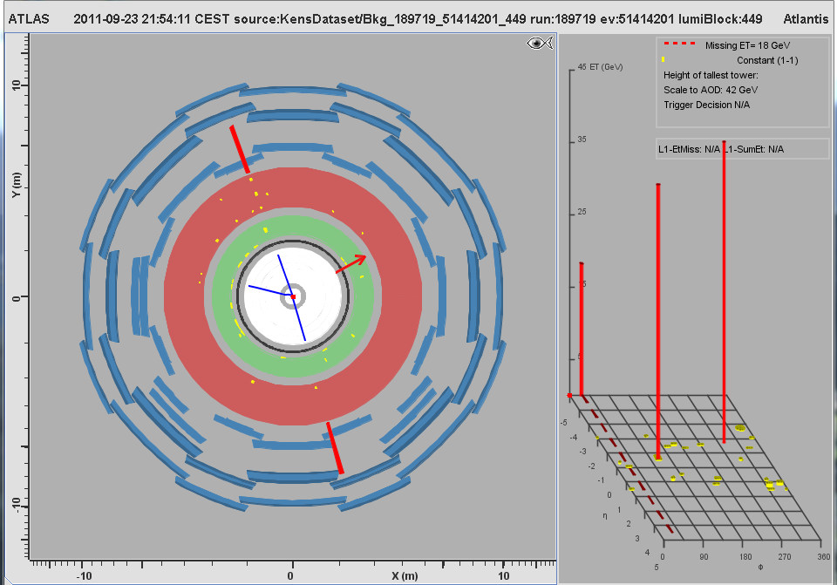
MC Event #162

Slide 4
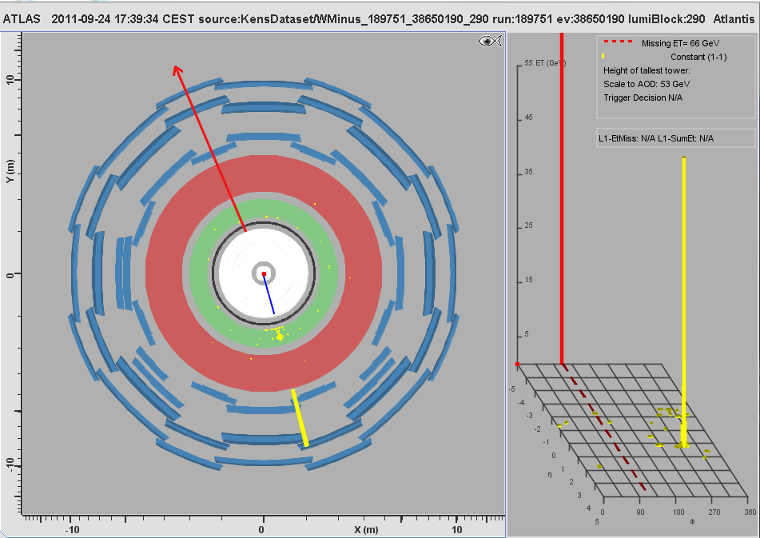
MC Event #163

Slide 5
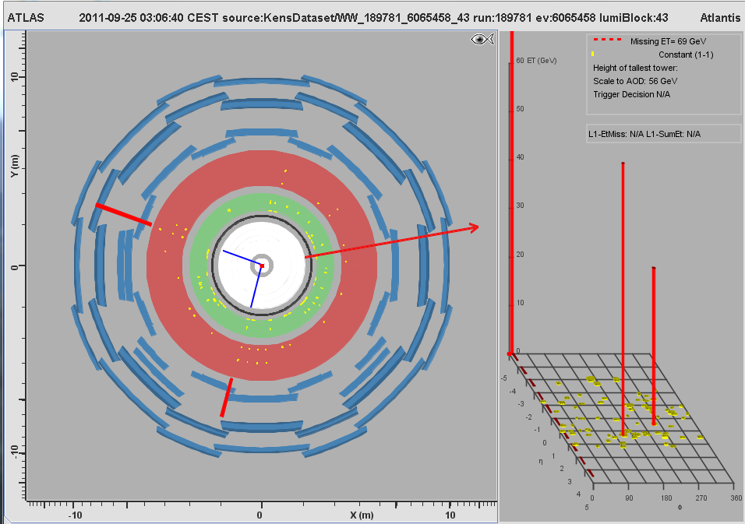
MC Event #164

Slide 6

MC Event #165

Slide 7
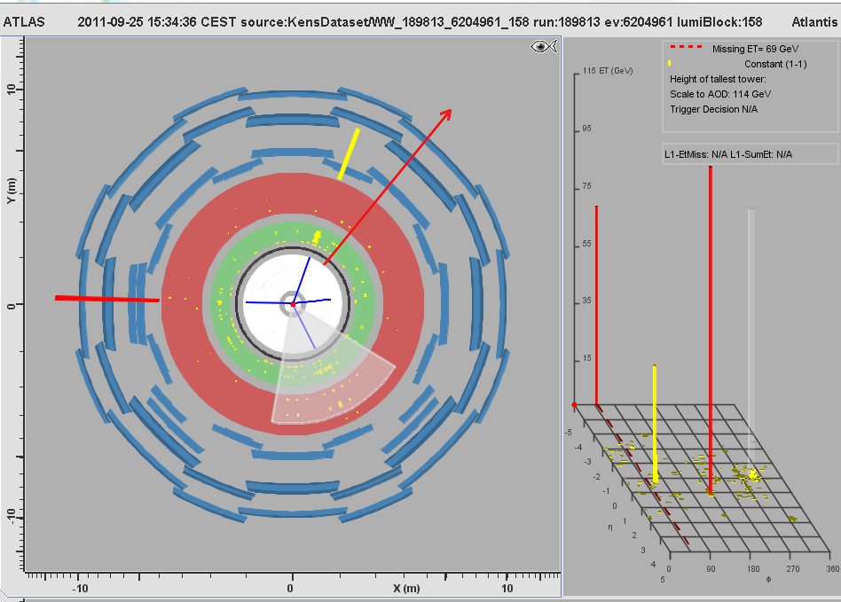
MC Event #166

Slide 8

MC Event #167

Slide 9
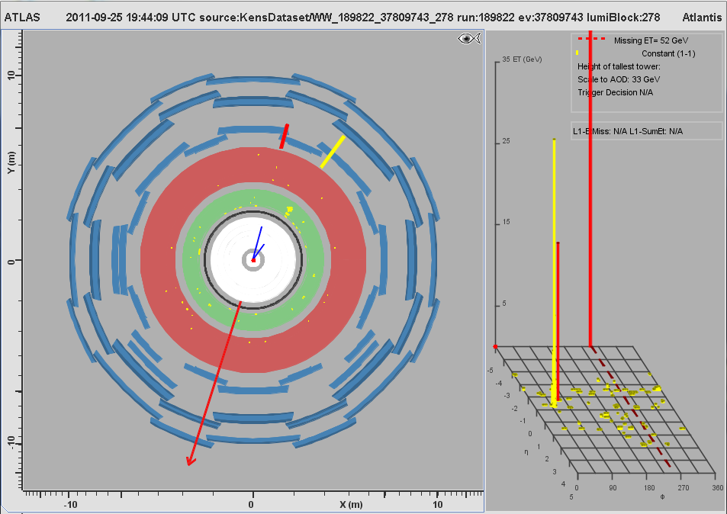
MC Event #168

Slide 10
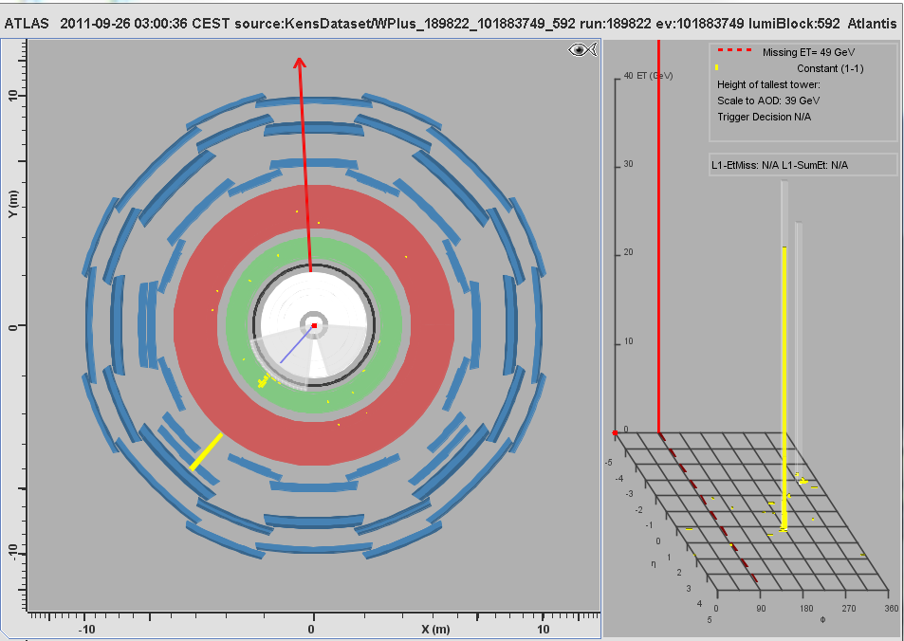
MC Event #169

Slide 11
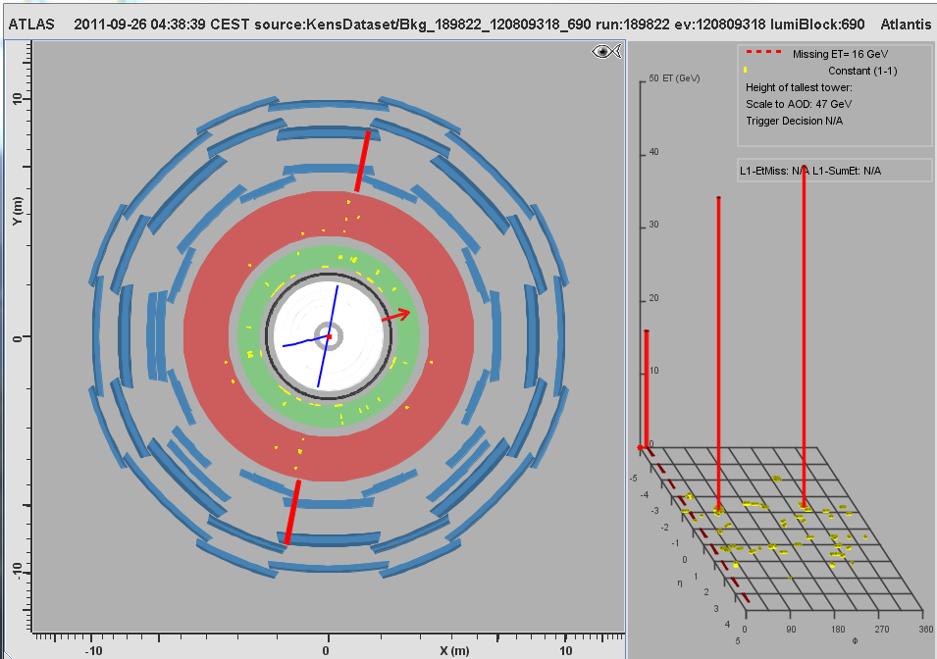
MC Event #170

Slide 12
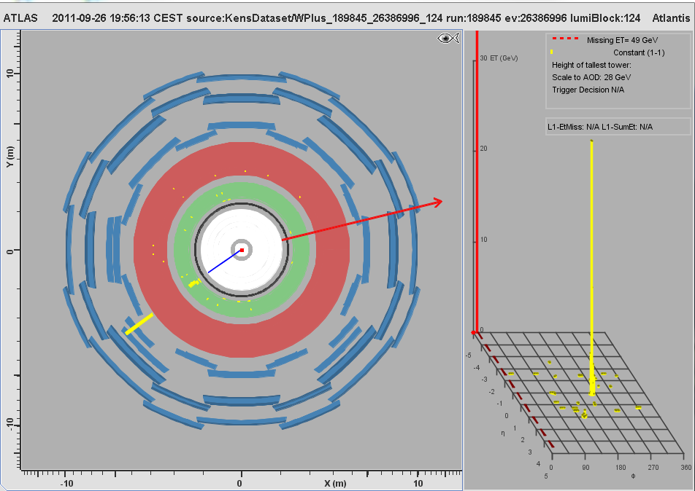
MC Event #171

Slide 13
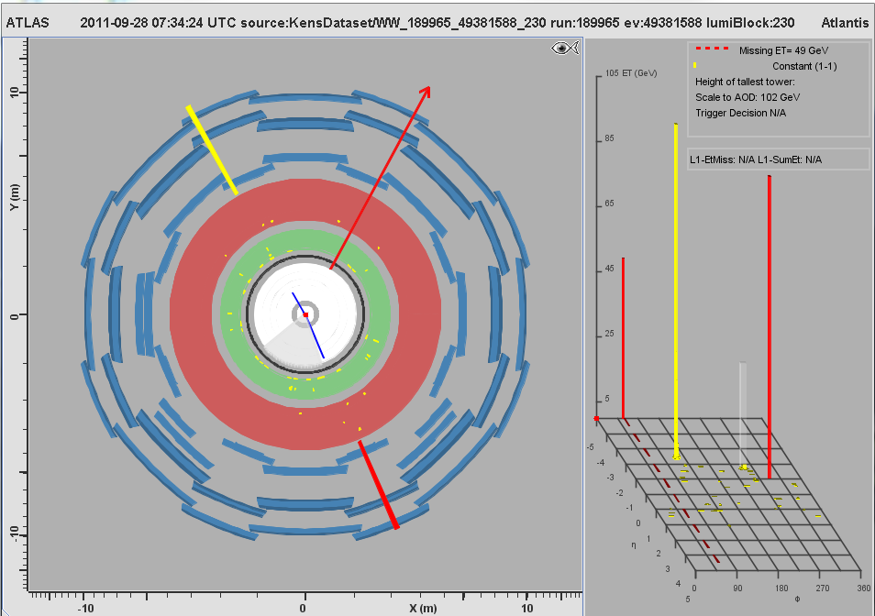
MC Event #172

Slide 14
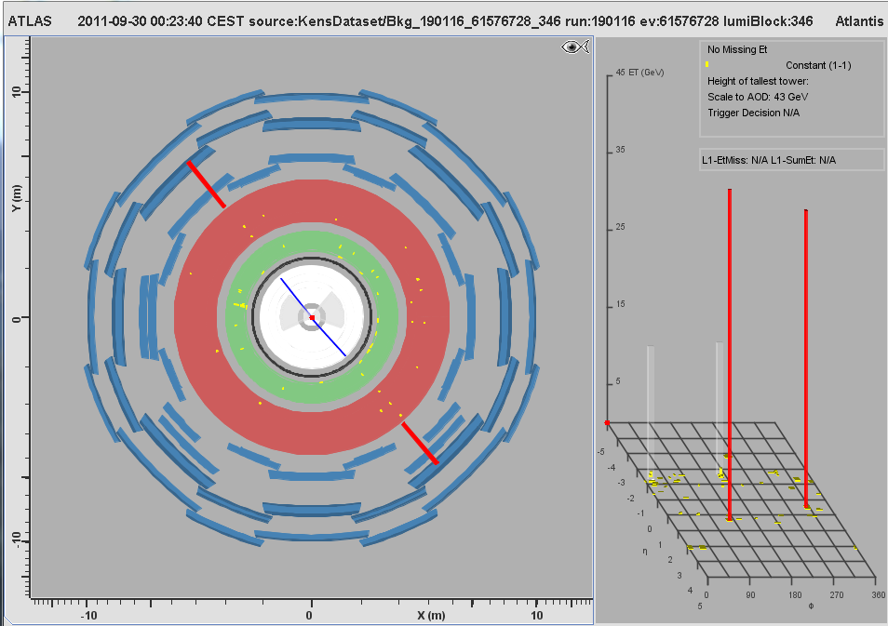
MC Event #173

Slide 15
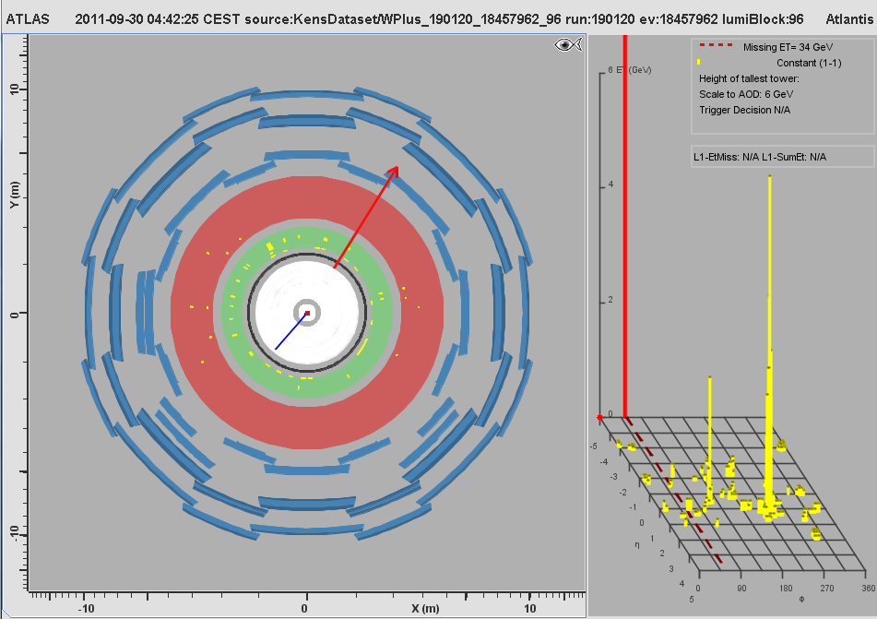
MC Event #174

Slide 16
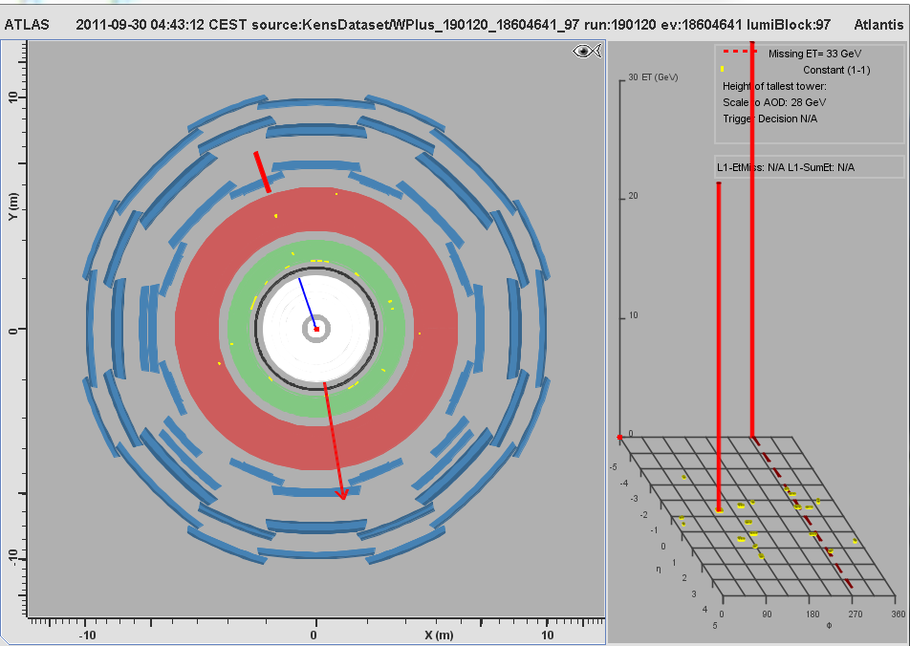
MC Event #175

Slide 17
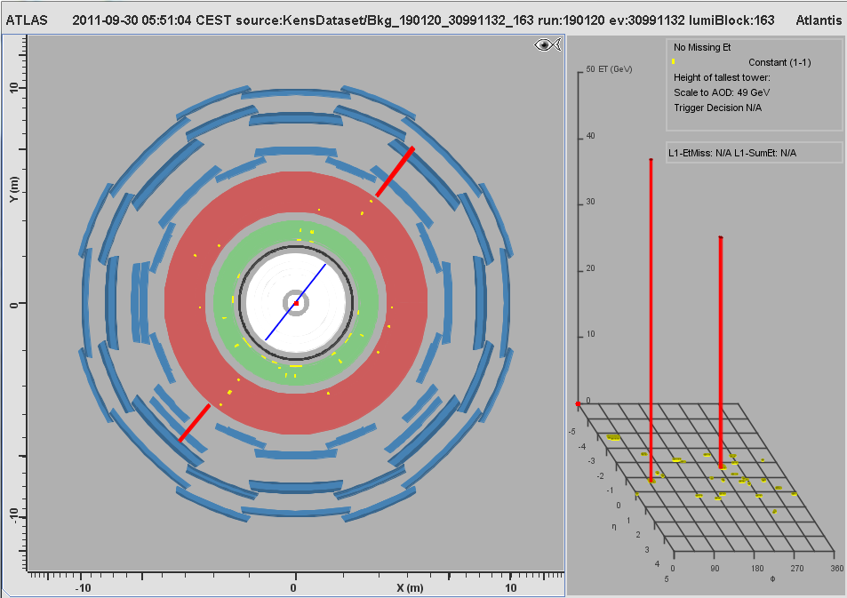
MC Event #176

Slide 18
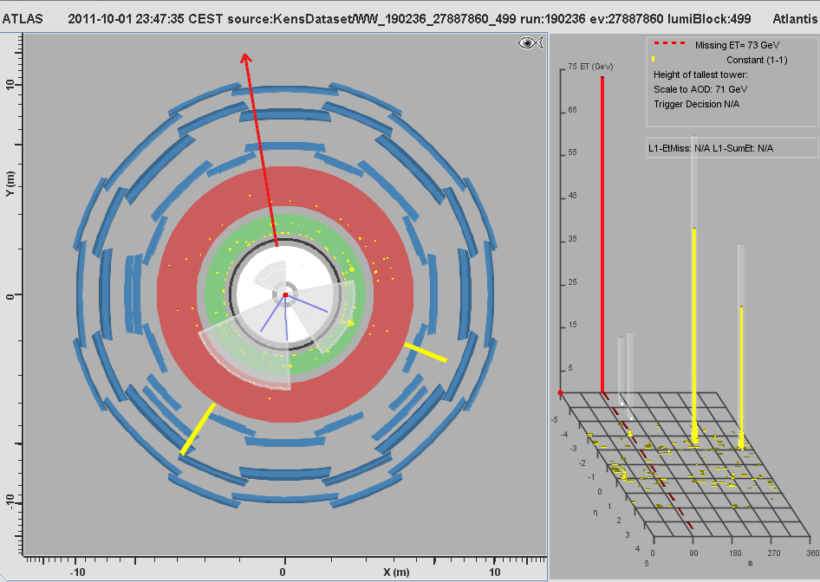
MC Event #177

Slide 19
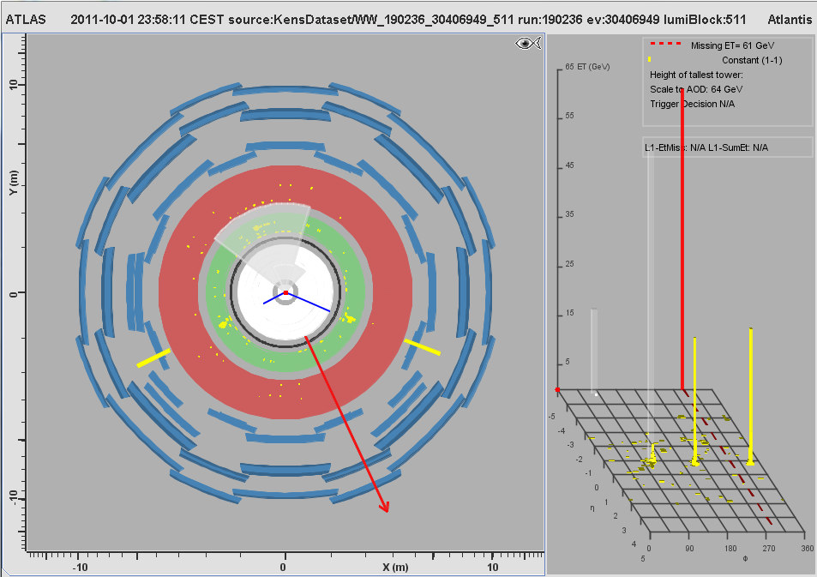
MC Event #178

Slide 20
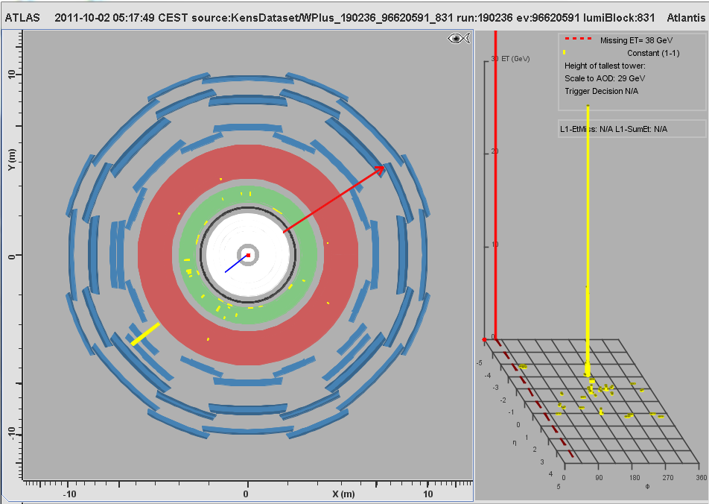
MC Event #179

Slide 21
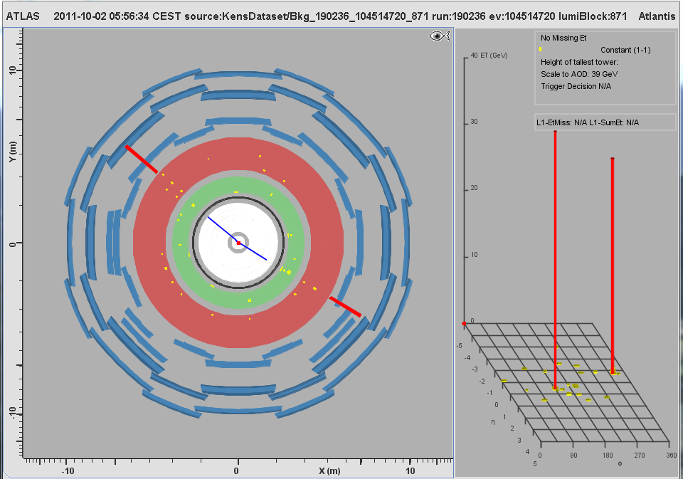
MC Event #180

Slide 22
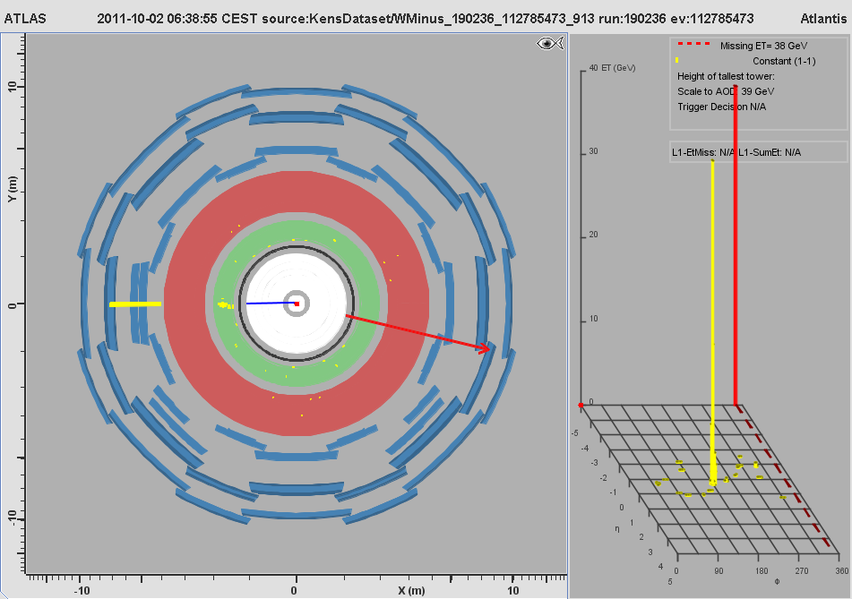
MC Event #181

Slide 23
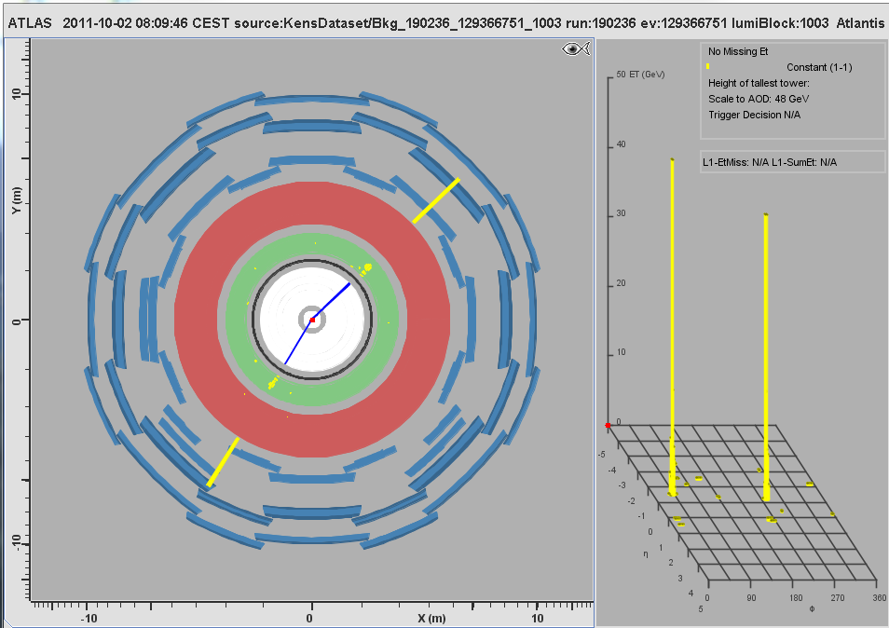
MC Event #182

Slide 24
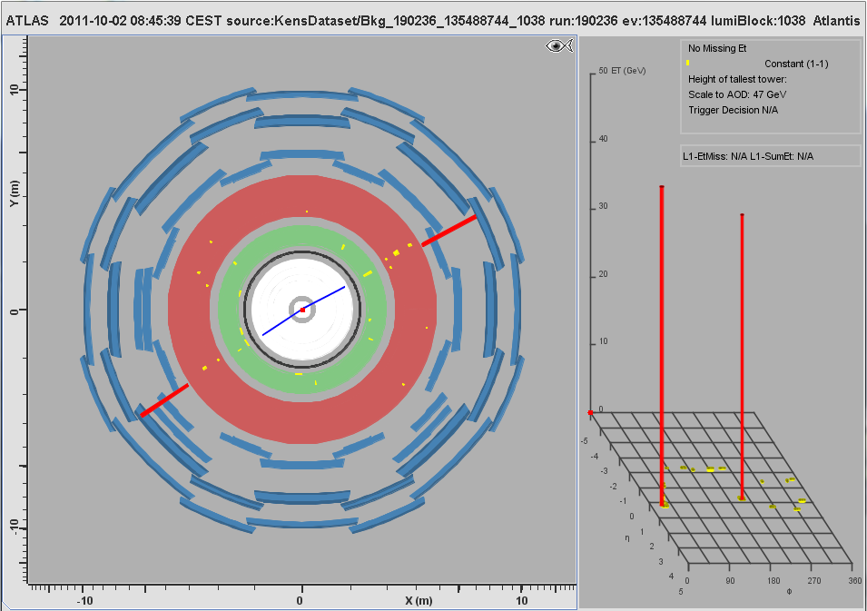
MC Event #183

Slide 25
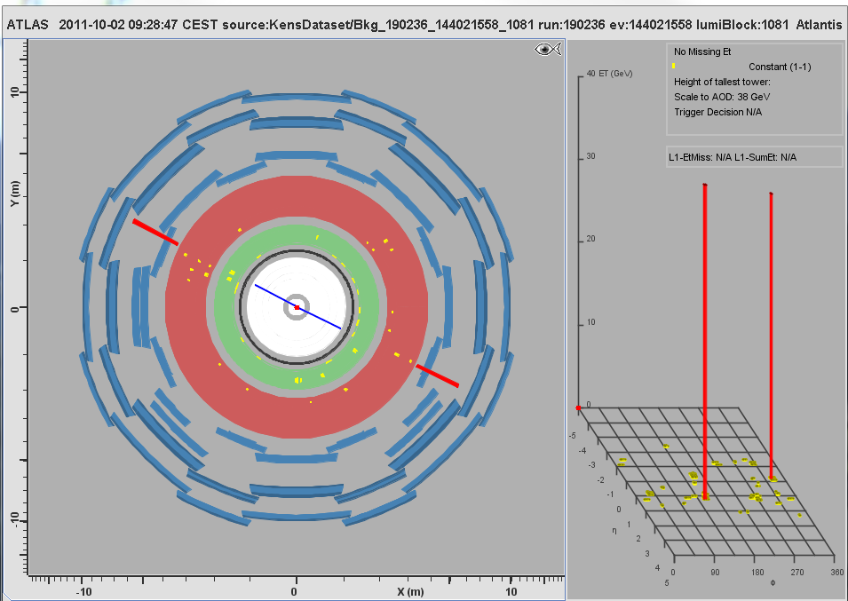
MC Event #184

Slide 26
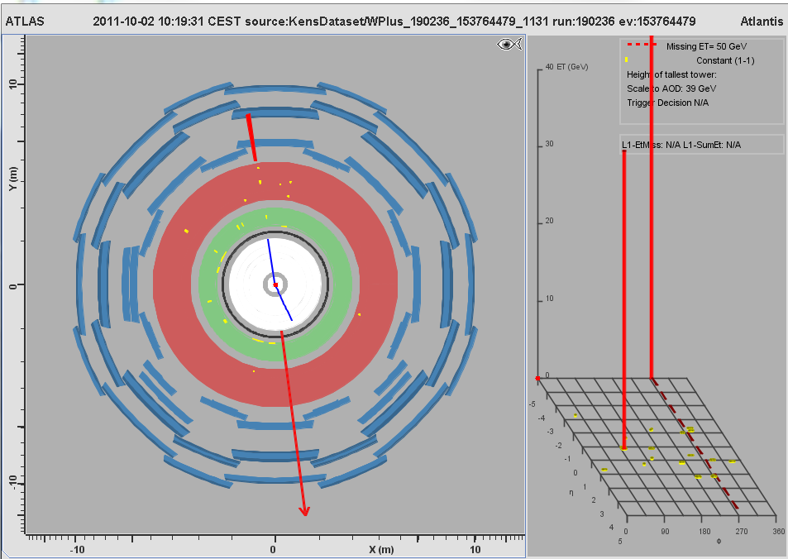
MC Event #185

Slide 27
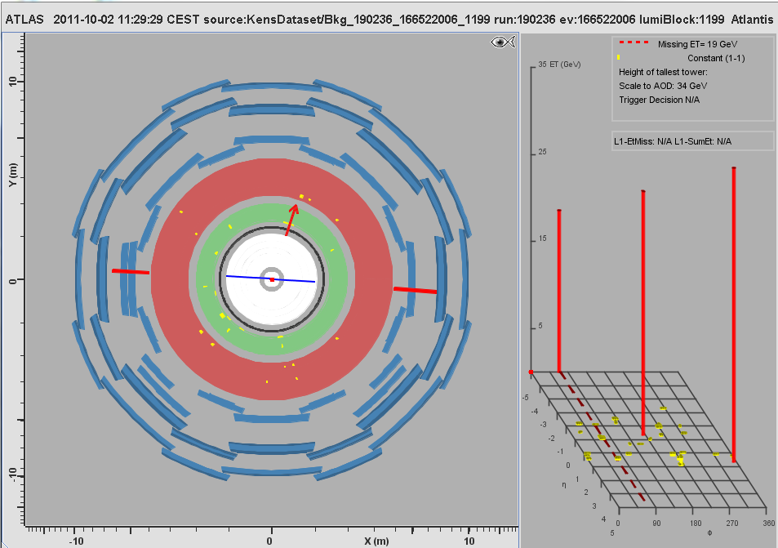
MC Event #186

Slide 28
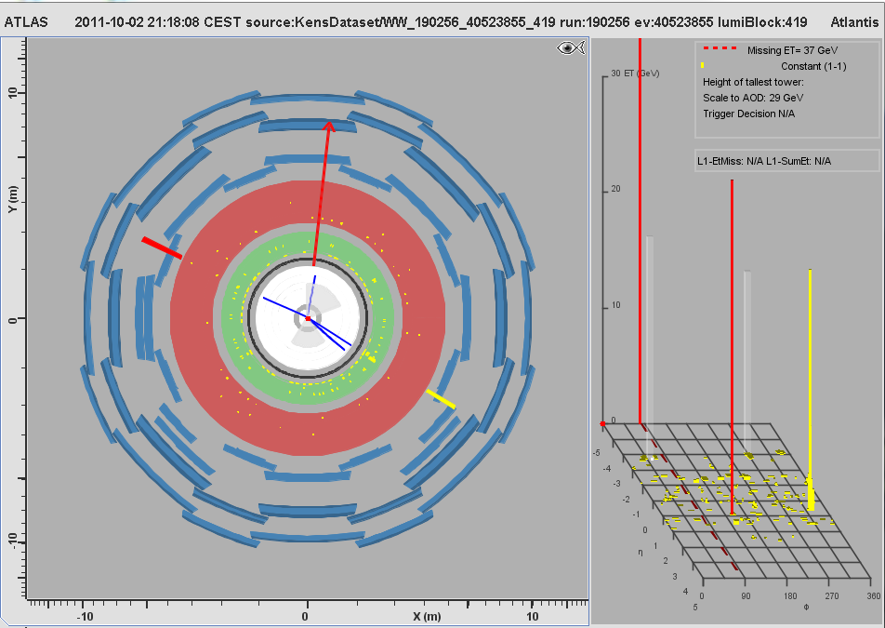
MC Event #187

Slide 29
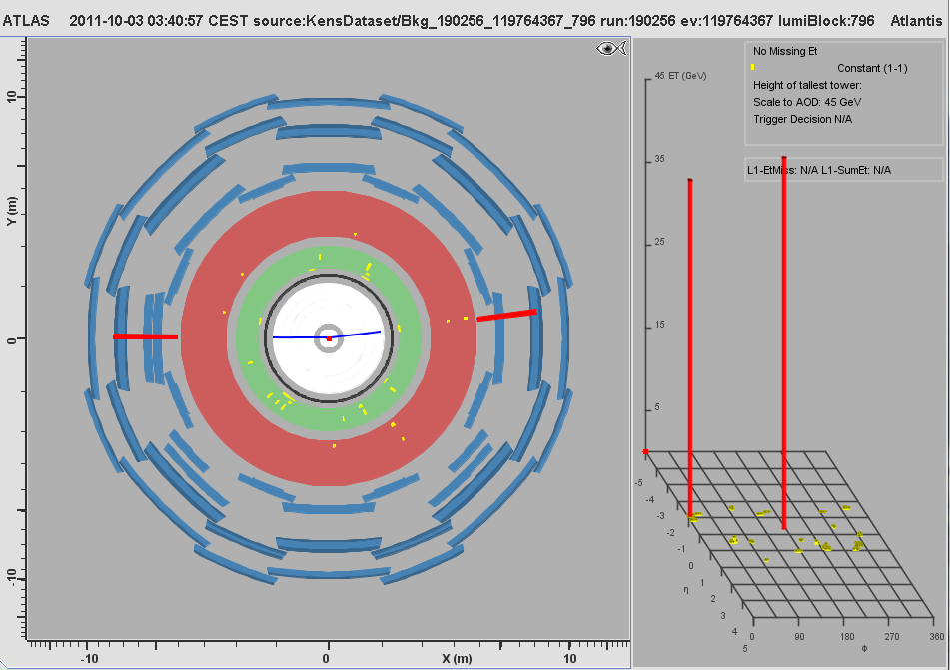
MC Event #188

Slide 30
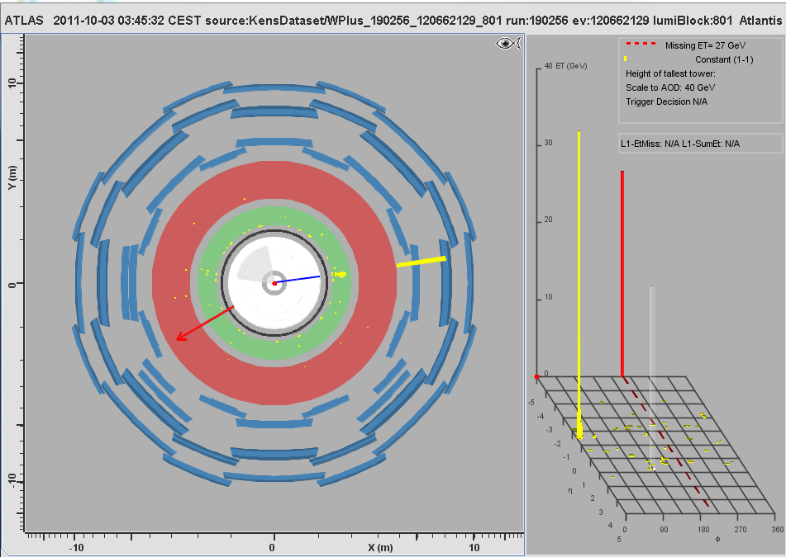
MC Event #189

Slide 31
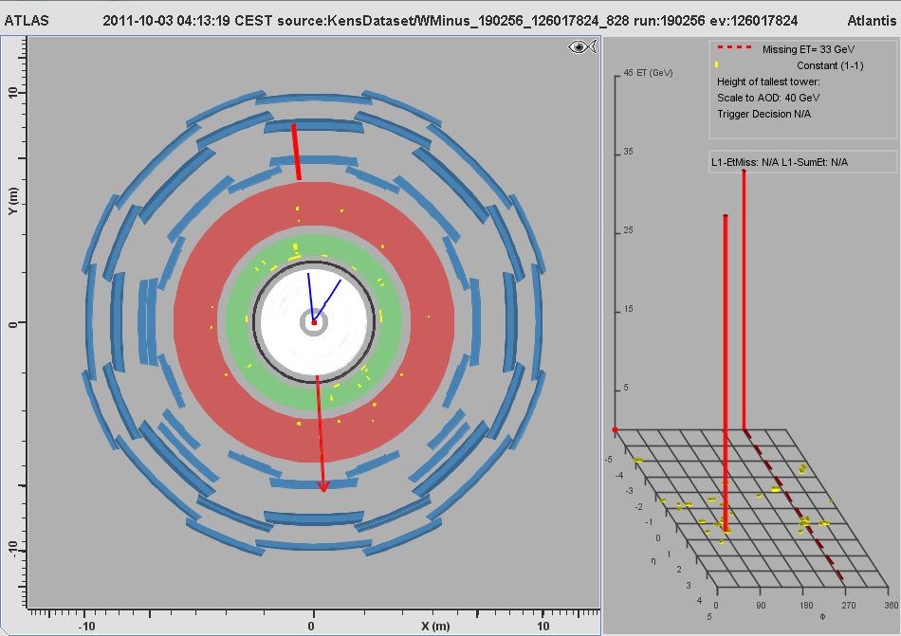
MC Event #190

Slide 32
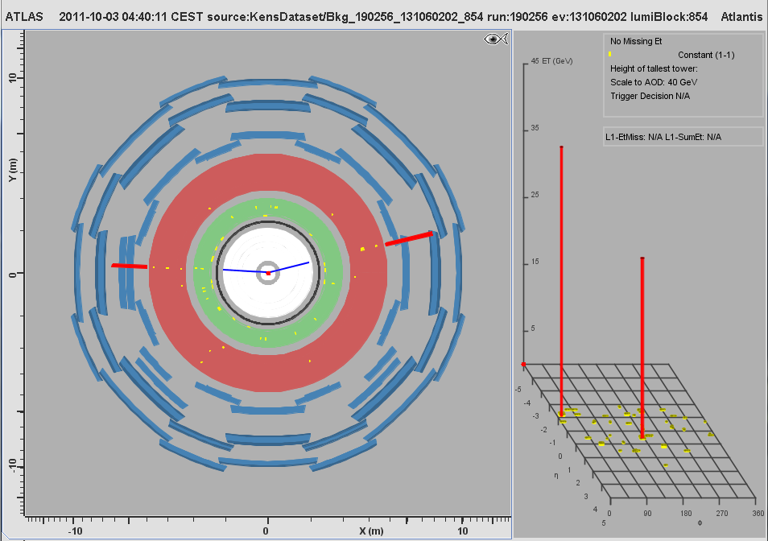
MC Event #191

Slide 33

MC Event #192

Slide 34
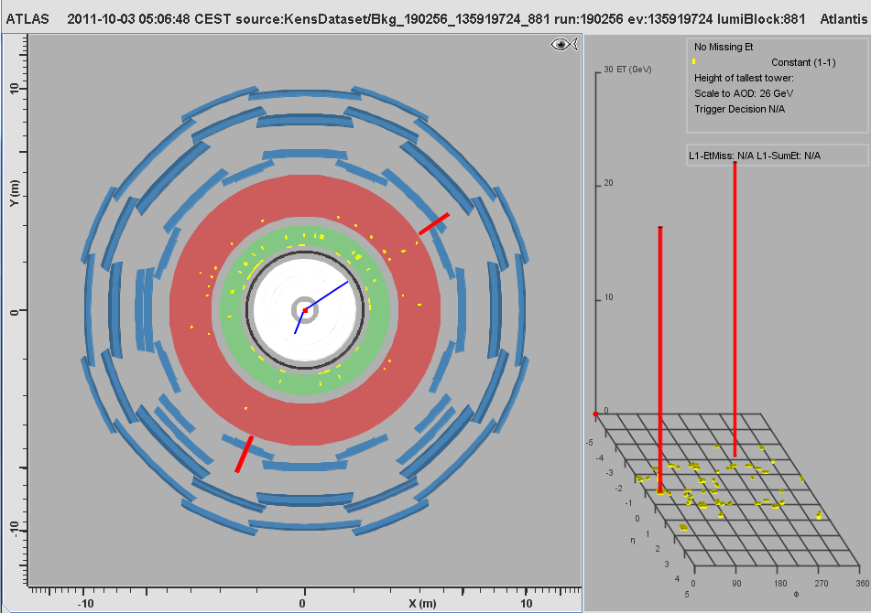
MC Event #193

Slide 35
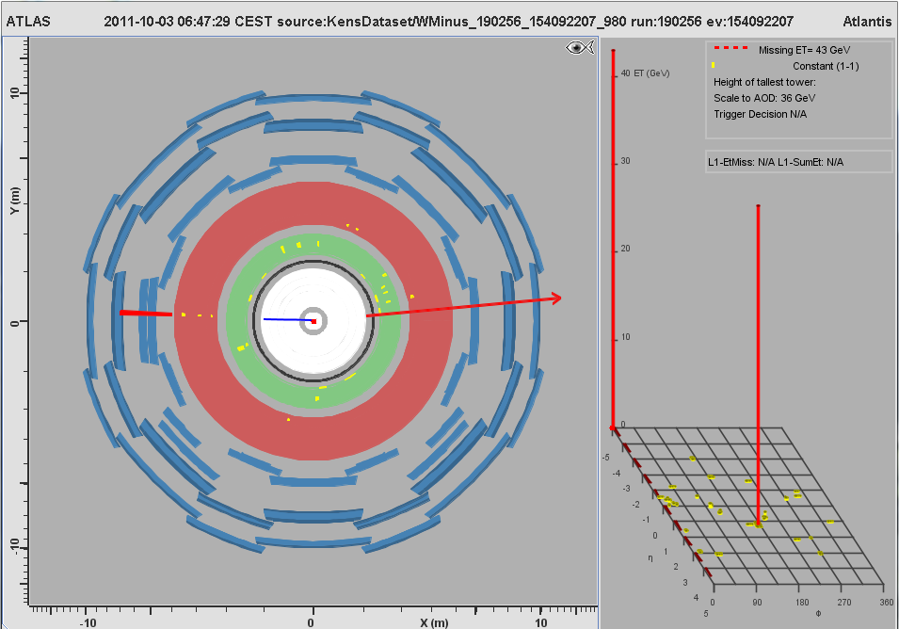
MC Event #194

Slide 36
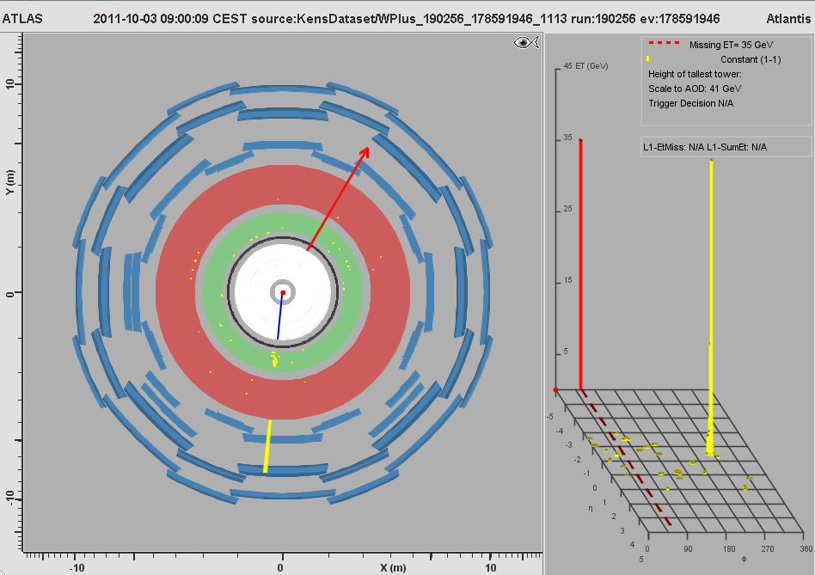
MC Event #195

Slide 37
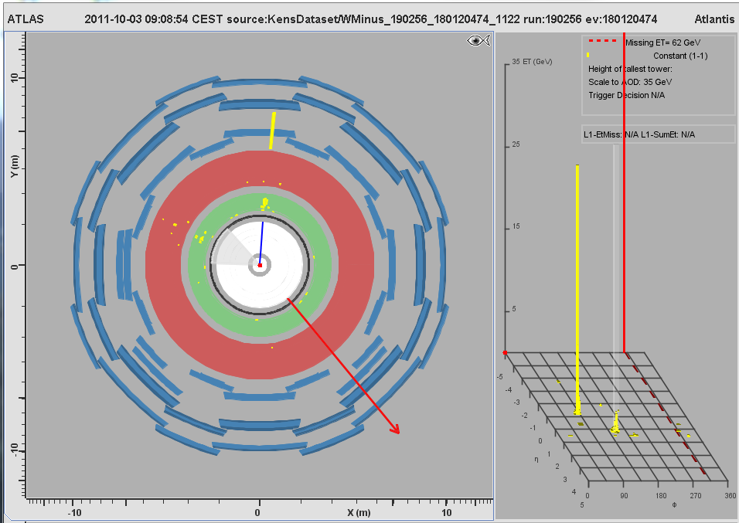
MC Event #196

Slide 38
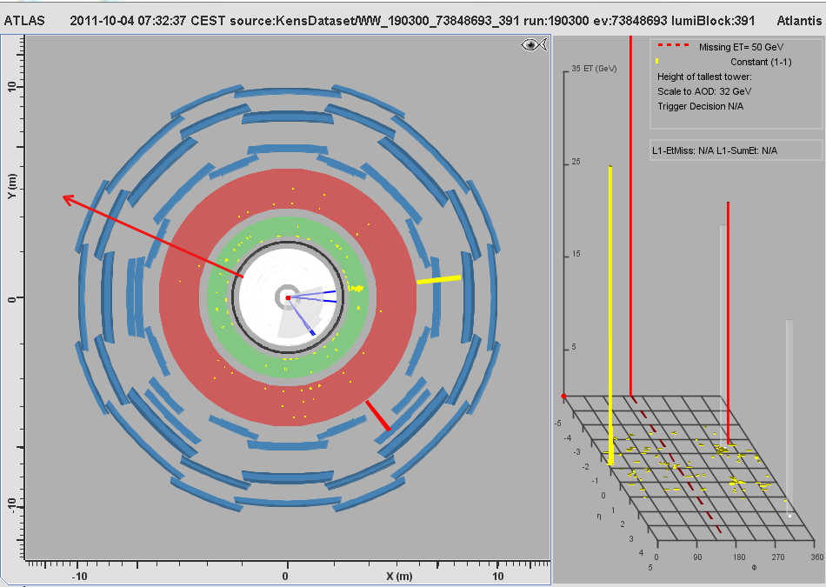
MC Event #197

Slide 39
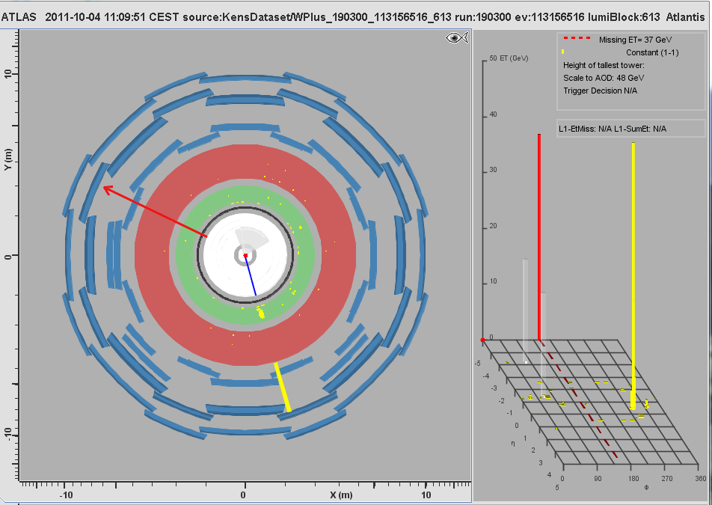
MC Event #198

Slide 40
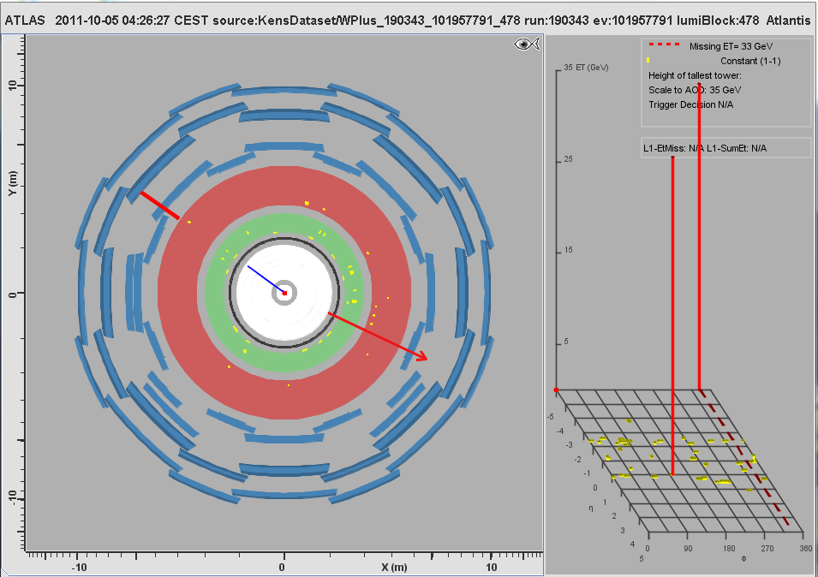
MC Event #199

Slide 41

MC Event #200

